Slide 1
INTRODUCTION TO TIME COMPLEXITY AND SPACE COMPLEXITY
Manisha Koranga
Assistant Professor
CSE Department
Graphic Era Hill University, Haldwani

Slide 2
COURSE OUTLINE
Criteria for Measurement
Time Complexity of an algorithm
Compile and Rum time Complexity
Types of Time Complexity
Standard Analysis Techniques
Example of Time Complexity
Space Complexity of an algorithm
Types of Space Complexity
Example of Space Complexity

Slide 3
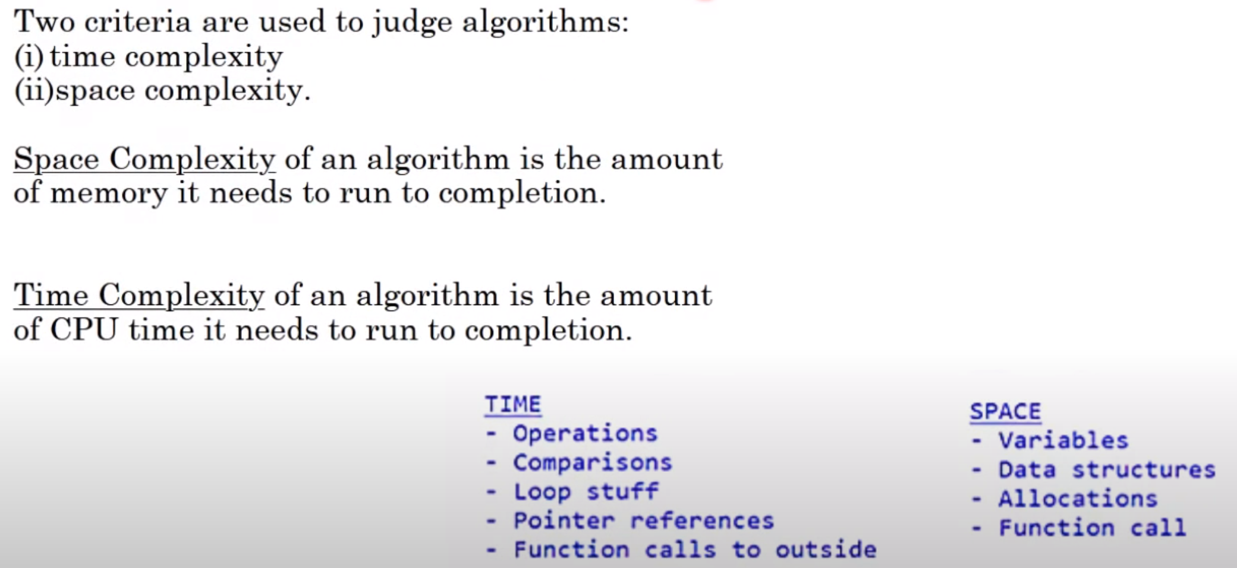
CRITERIA FOR MEASUREMENT

Slide 4
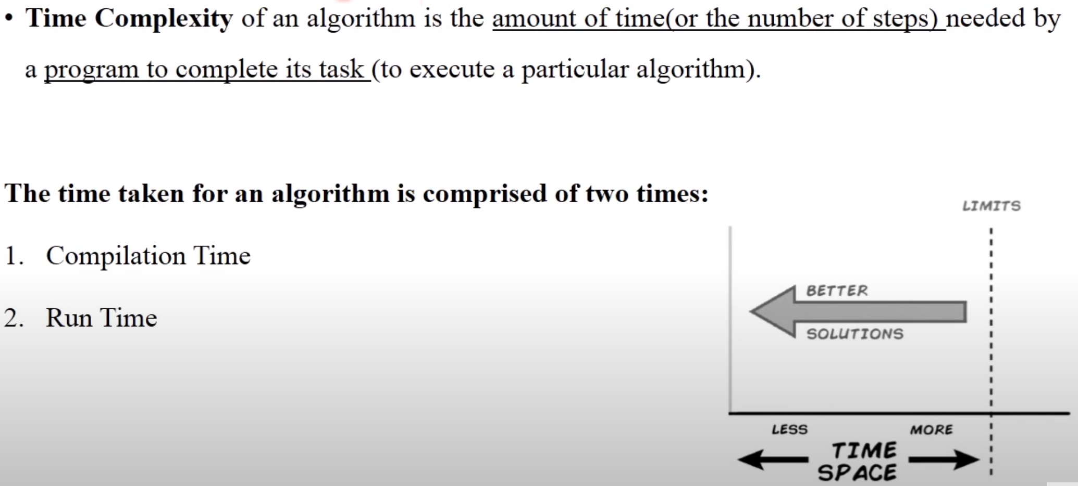
TIME COMPLEXITY OF AN ALGORITHM

Slide 5
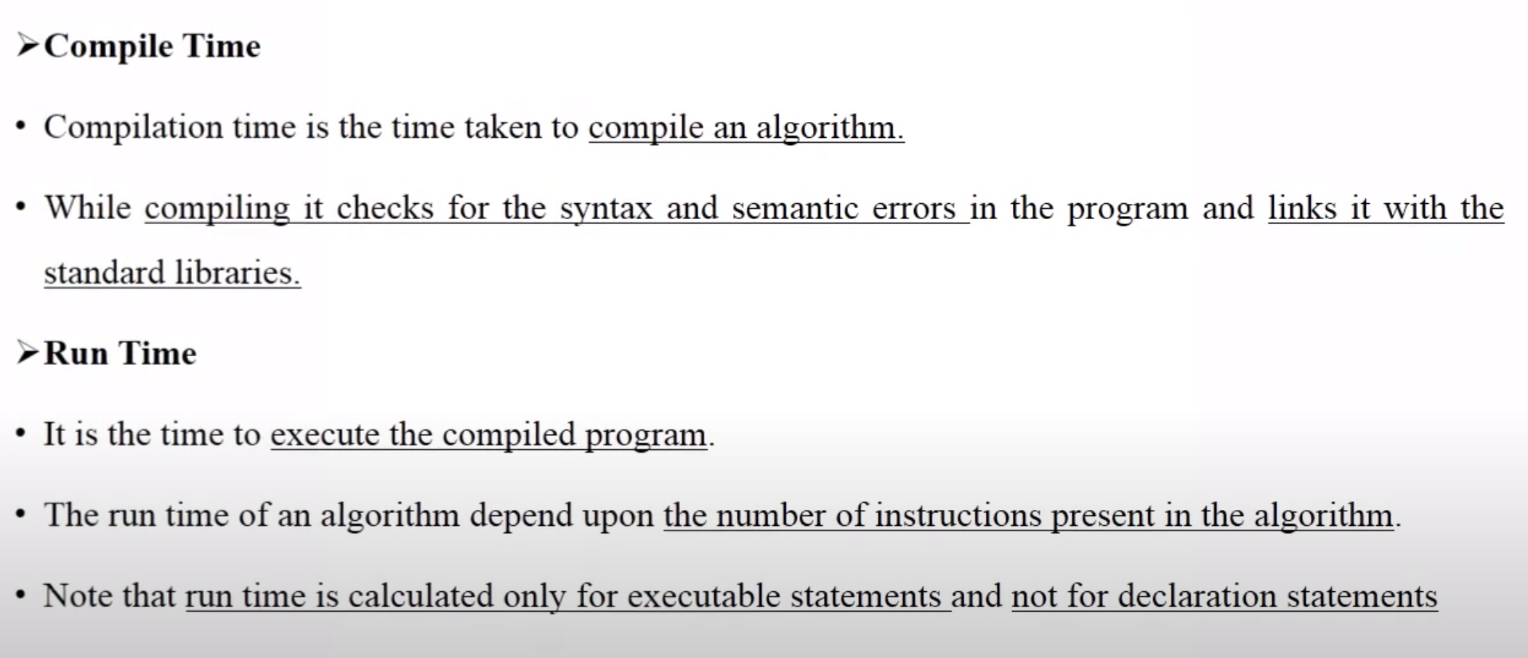
COMPILE AND RUM TIME COMPLEXITY

Slide 6
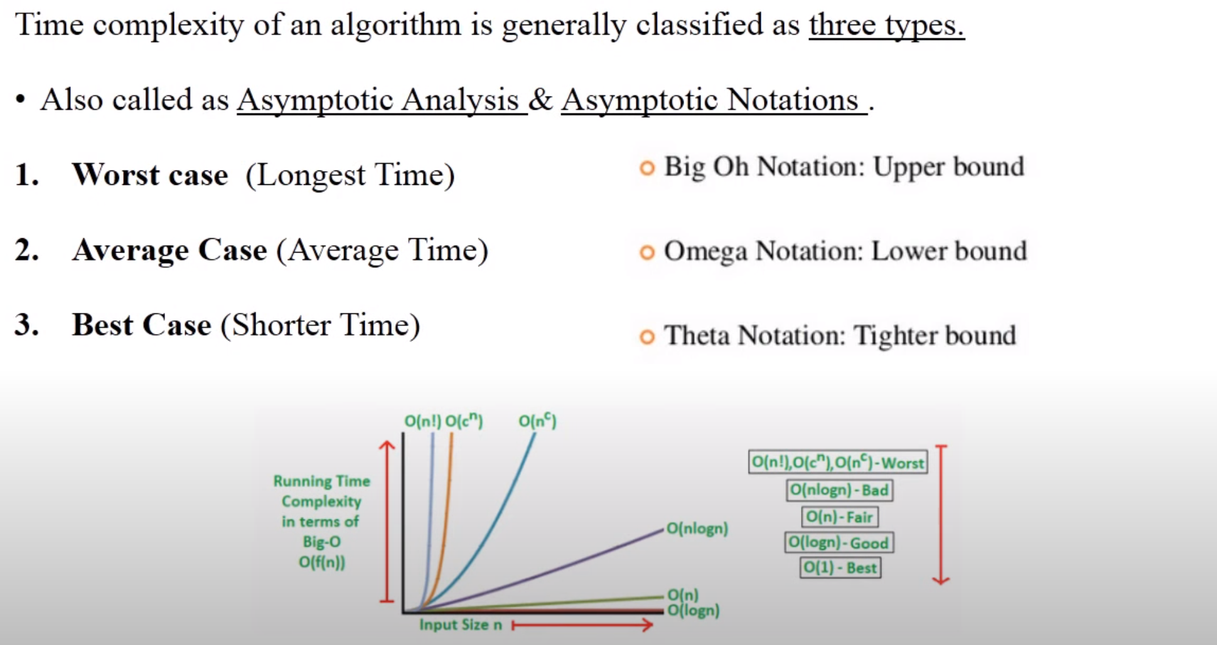
TYPES OF TIME COMPLEXITY

Slide 7
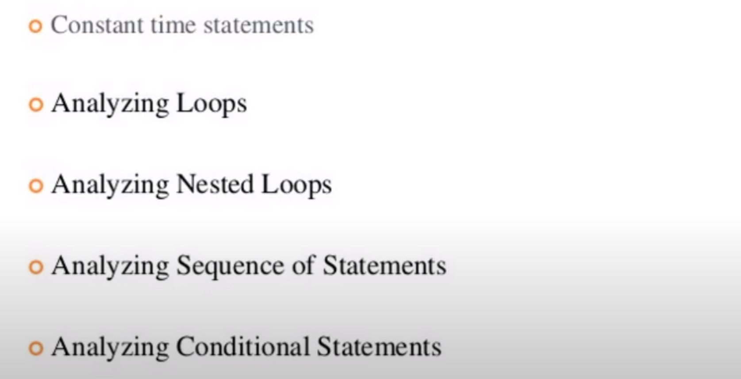
STANDARD ANALYSIS TECHNIQUES

Slide 8
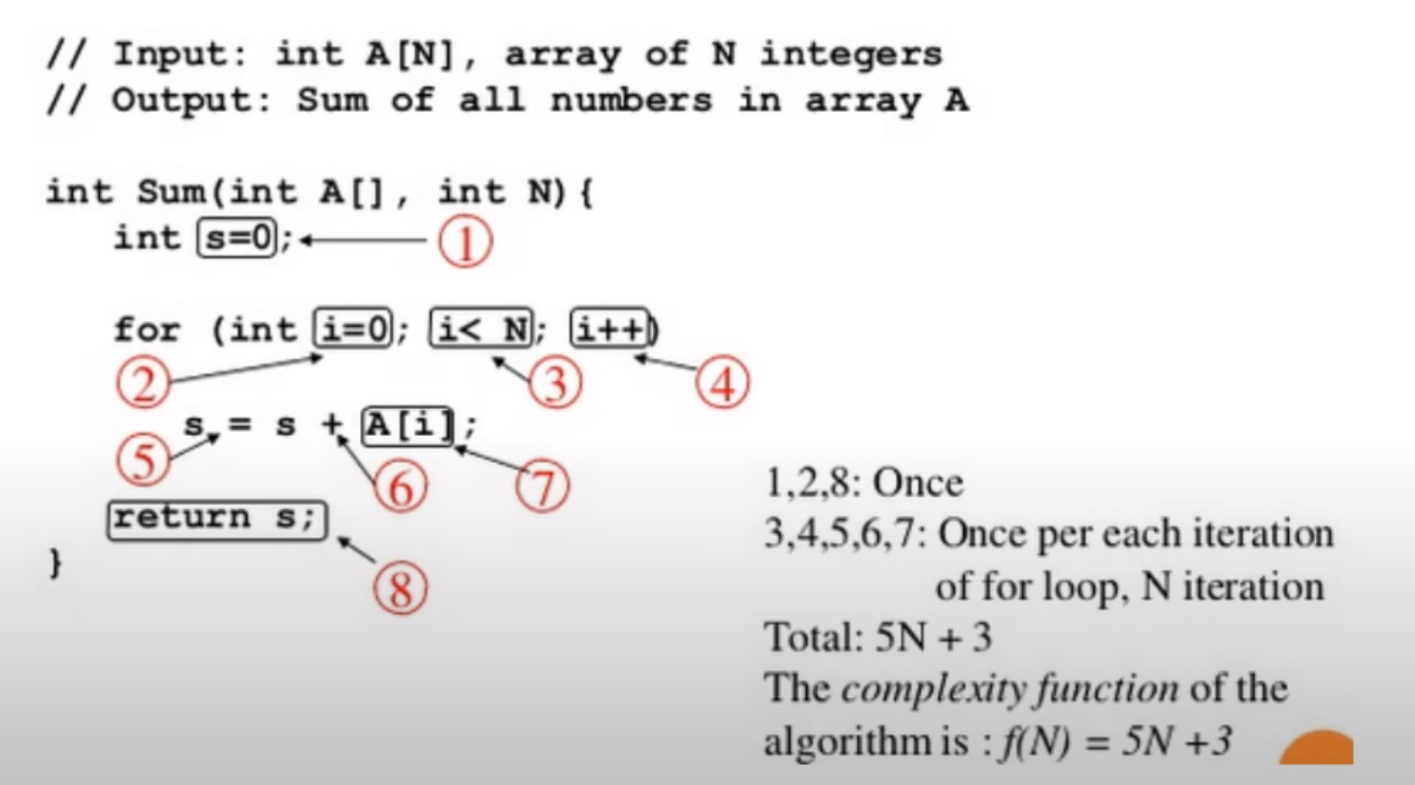
EXAMPLE OF TIME COMPLEXITY

Slide 9
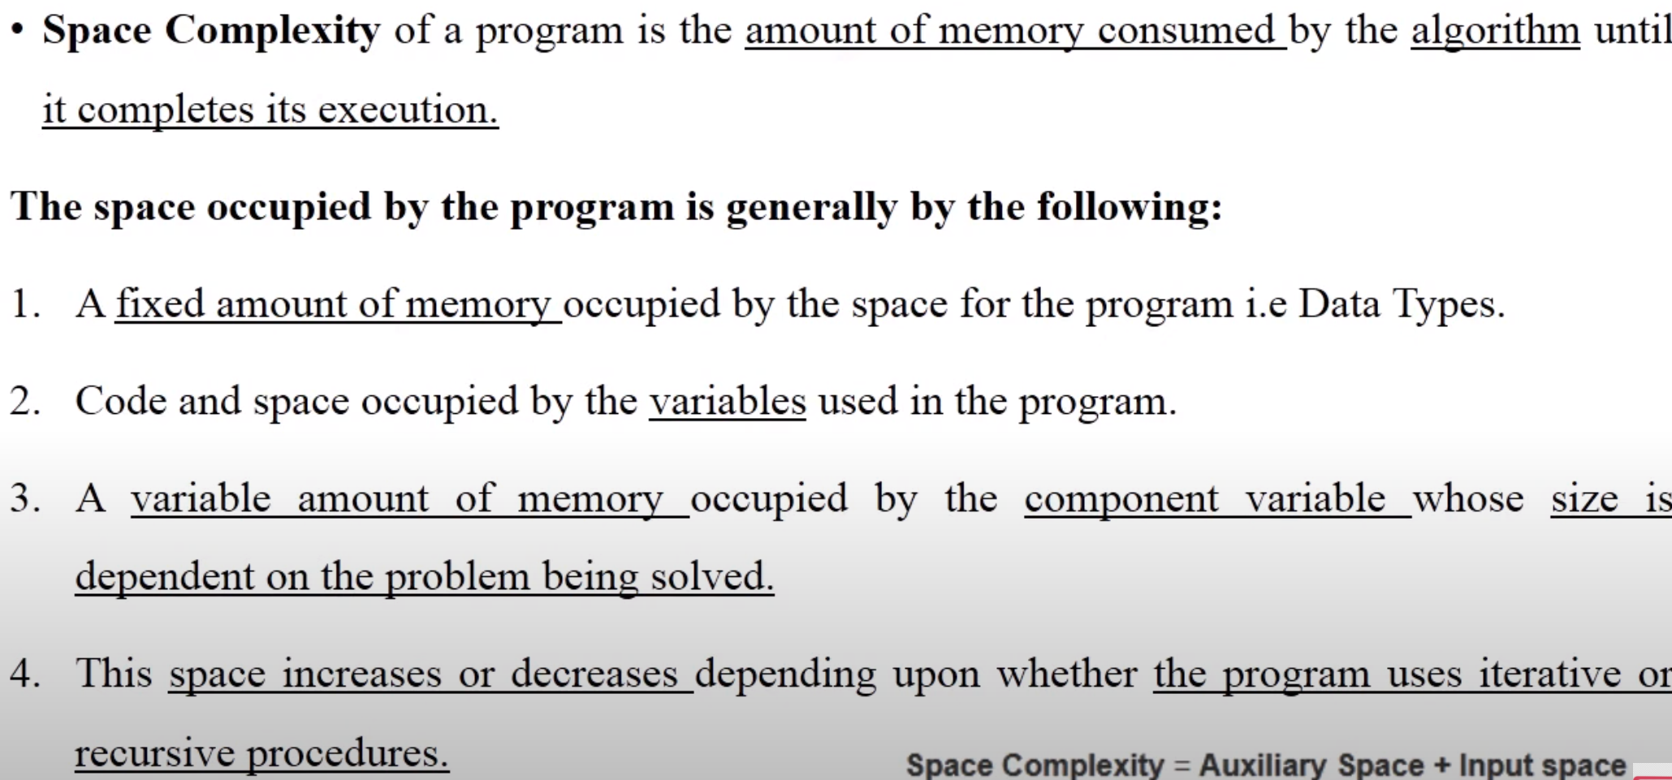
SPACE COMPLEXITY OF AN ALGORITHM

Slide 10
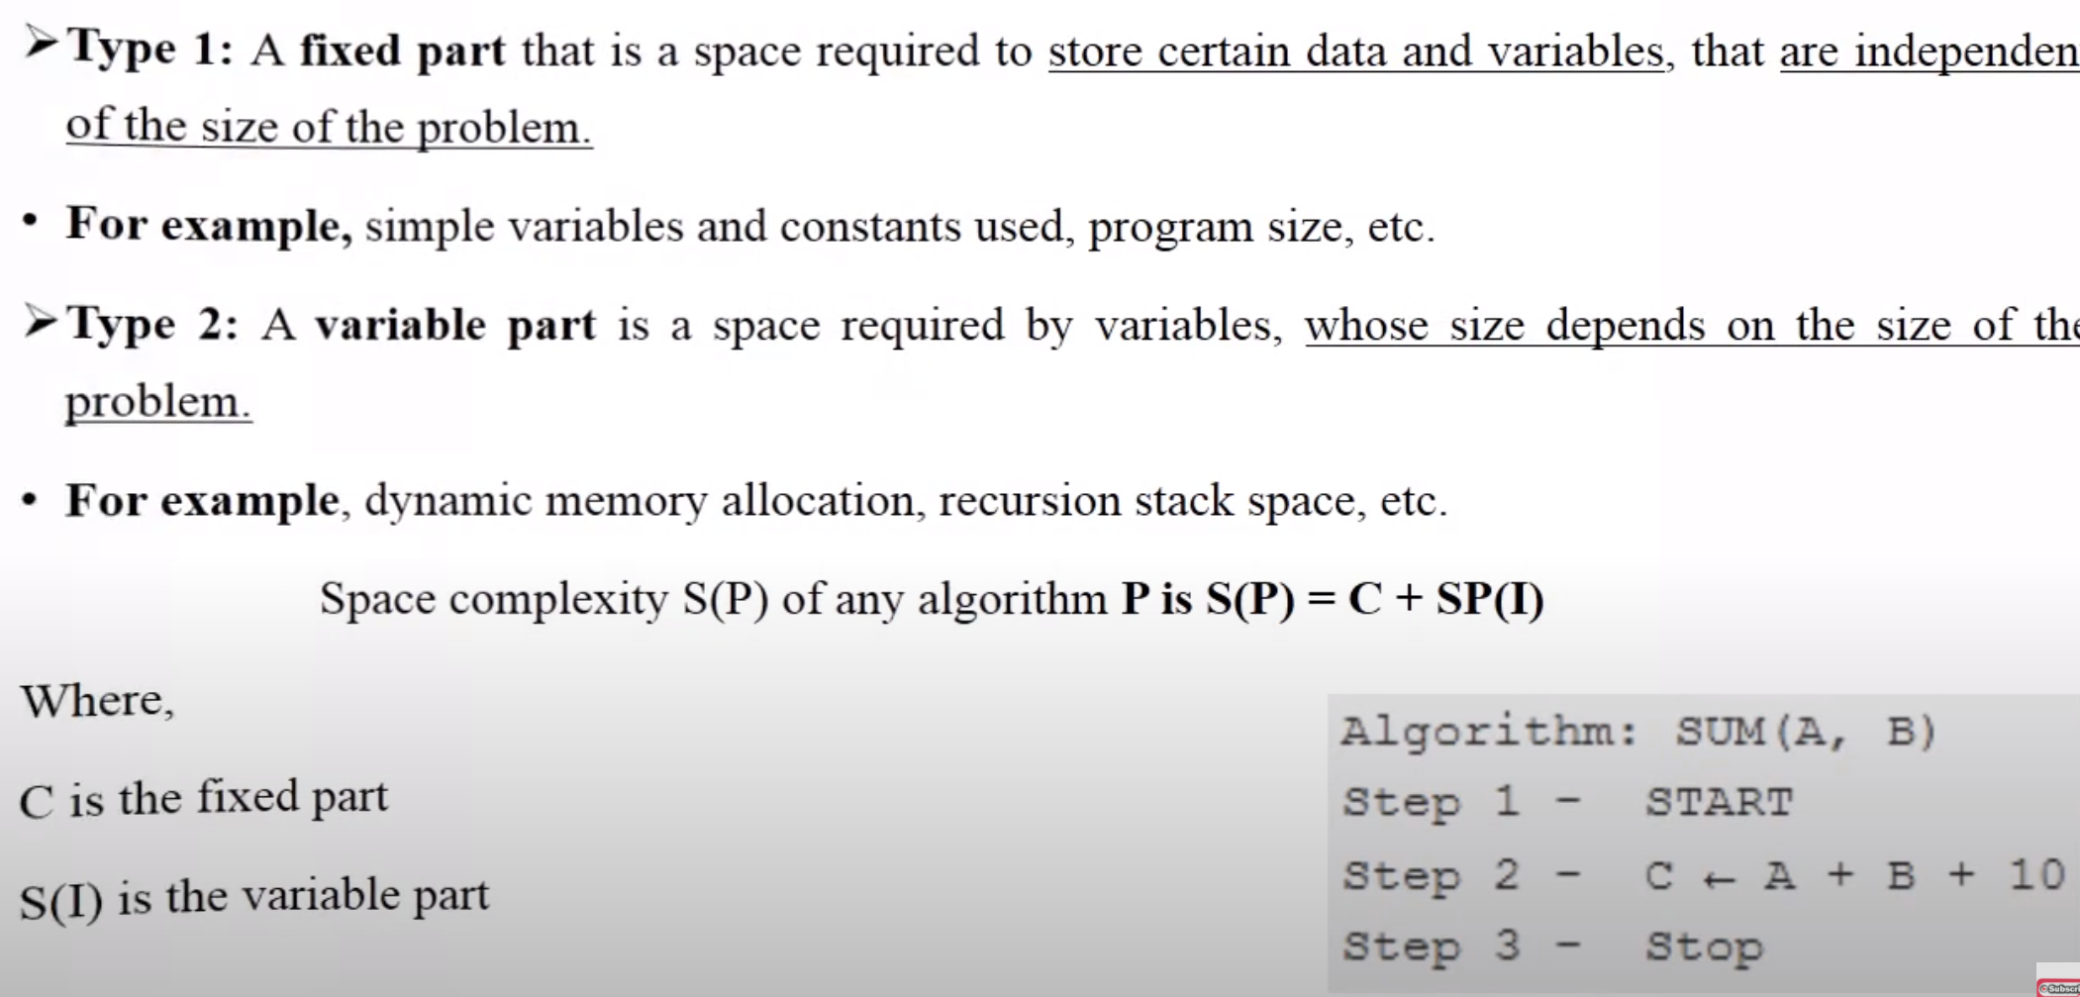
TYPES OF SPACE COMPLEXITY

Slide 11
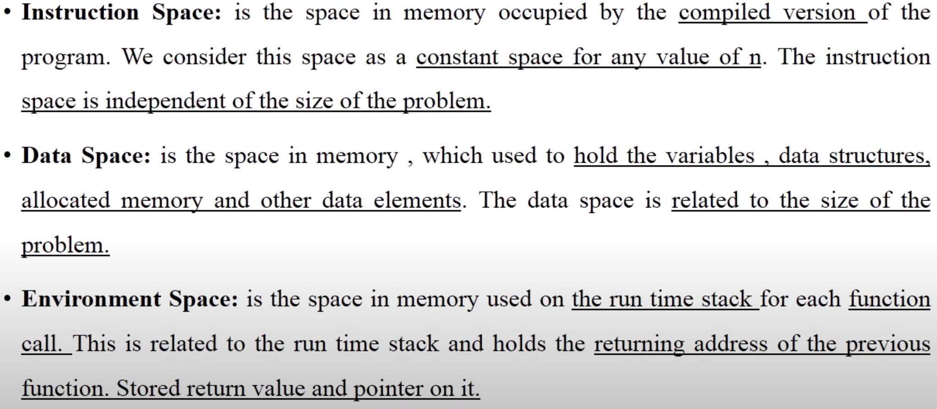
OTHER TYPES OF SPACE

Slide 12
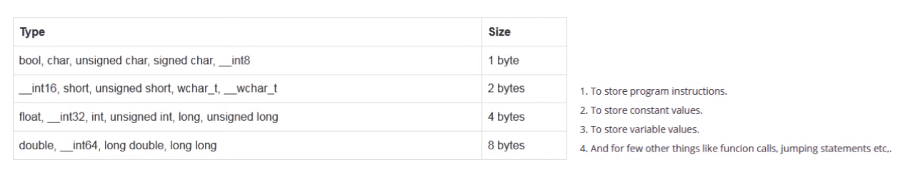
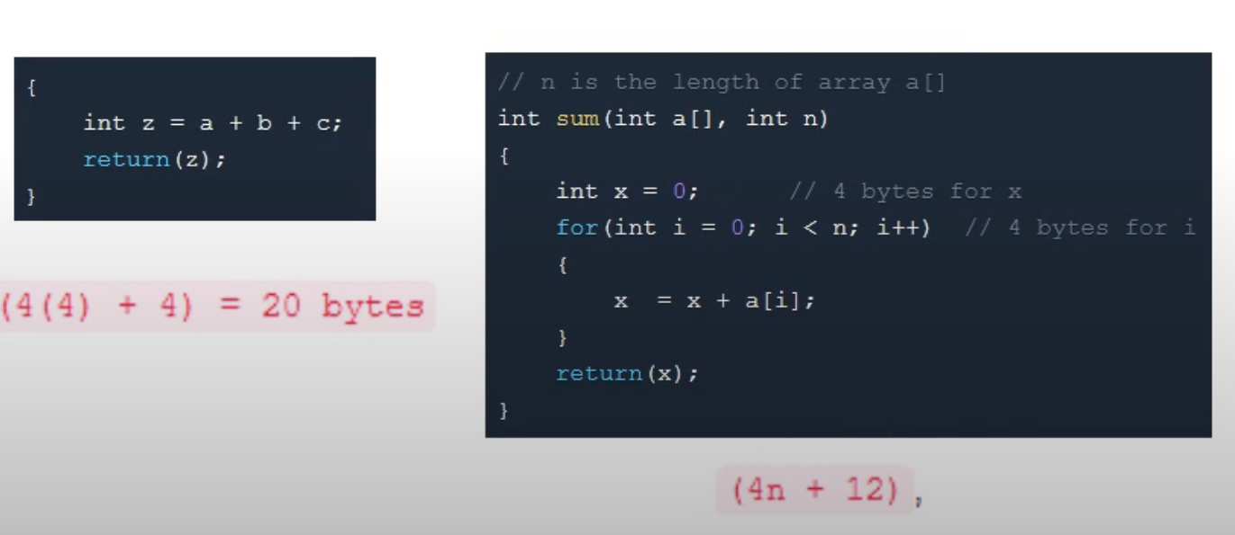
EXAMPLE OF SPACE COMPLEXITY

